Slide 1

Precision Agriculture
PROJECT by
ABHISHEK KUMAR

Slide 2
About GreenScanAI
VISION
MISSION
GreenScanAI's aim is to use cutting-edge artificial intelligence and computer vision technology to change agriculture in India. We are committed to providing farmers with an AI-trained CV device (mobile phone, drone, or satellite) that efficiently identifies crop illnesses while also promoting healthier yields and sustainable agricultural methods. We aim to build a future where every farmer can confidently tackle crop diseases, assuring food security and prosperity by combining local expertise, cutting-edge algorithms, and a deep grasp of Indian agricultural needs.
Empowering Agriculture with Precision and Insight
GOALS
Short Term
Launch Product for 3 Crops
Long Term
Expand Market Reach and include more Crops
INDUSTRY FOCUS
Agriculture

Slide 3
Potential of the Idea
Problem Statement
Farmers' mass migration from rural to urban regions has resulted in a scarcity of competent agricultural employees. GreesScanAI seeks to overcome this problem by putting such knowledge at the user's fingertips. GreenScanAI's future seems bright in India. The following are some of the important reasons that will contribute to its development and success:
Increasing Adoption of AI in Agriculture
Government Support for Agri-Tech
Growing Awareness and Education
Expansion to More Crops
Technological Advancements
Potential for Customization
Data-driven Improvements

Slide 4
Journey of Need to Solution
UNDERSTANDING CUSTOMER NEEDS
Mobile First Approach
UI/UX Design
Real Time Disease Diagnosis
Disease Information by Region
Multilingual Assistance
Offline Functionality
Simple Image Capture and Upload
Integration with Farm Management System
Data Privacy and Security
Transparent Pricing and Affordable Plans
Community Engagement
TRANSLATING TO A SOLUTION WITH
High Accuracy
Crop Diversity
Real Time Detection
Offline Functionality
User Friendly Interface
Localization
Cost Effectiveness
Educational Resources
Collaboration with Experts
Scalability
Crops Covered
Geo Locations
Value Added Services

Slide 5
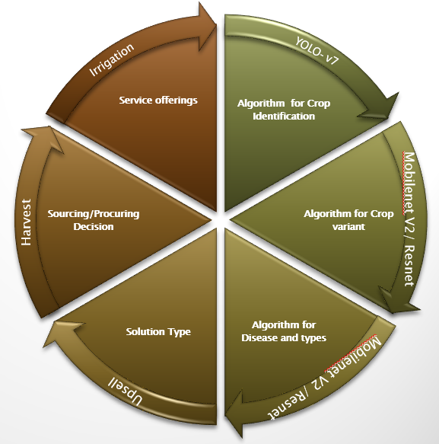
Solution at a Glance
2. Solution at a Glance
Crops: Toor Dal, Tomato, Grapes.
Solution focusing on one Crop, Vegetable and Fruit each
Transfer Learning to expand the model for more crops
A holistic solution addressing consulting and services to farmers starting from seed selection till harvesting
Main focus on identifying Pests, Weeds, Fungus using Computer Vision and AI model to generate Specific recommendation
Options for Farmers to click pictures of the field via their Mobile Phones or in higher levels of service through Drones and Satellites.
These images would be processed by the AI model to generate specific recommendations.

Slide 6
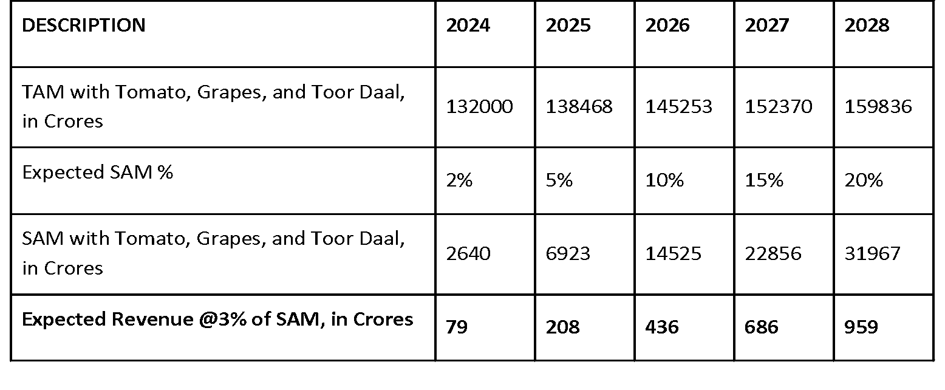
Understanding the Market
3. Market Size
Market Size
Target Market
The Indian Agriculture market value stood at 435.9 Billion USD as of 2022 and formed 16.5% of the GDP. This is expected to grow at a CAGR of 4.9% and reach 580.82 Billion USD by 2028. Agritech Startups have made quite a mark in the Indian Agriculture space and are expected to have a market of close to 35 Billion USD by 2027 (As per the Avendus Capital Report). These Agritech companies are working on three kinds of Business models: margin-based, subscription-based,and transaction based. Investment in the Indian Agritech industry was worth USD 242 Million in 2020 alone.
If we just target the three identified markets of Tomato, Grapes and Toor Daal then,
The TAM (Total Addressable Market) is valued at INR 1,32,000 Crores currently.
Even a 2% SAM (Serviceable Addressable Market) in the initial phase gives a Market value of INR 2640 Crores.
Considering a nominal 3% subscription cost of the Market Value we can look at revenues of INR 79 Crores in the 1st year of operation itself.
The revenues will continue to expand exponentially as we add more crops and increase the reach of the existing market.
We will be targeting with our product
Farmers
Agricultural Extension Services
Agritech Companies
Government Initiatives

Slide 7
Competition Analysis
4. Competition
Factor | Imp to Customer | Green ScanAI | Cropin | Agribolo | Blue River | Farm Wise | DeHaat | Tartan Sense | AI Bono
Product | 1 | S | W | W | S | S | W | W | W
Price | 1 | S | W | S | W | W | S | W | W
Quality | 1 | S | S | W | S | S | W | W | S
Selection | 3 | S | W | W | S | W | W | W | W
Service | 3 | S | W | W | S | S | W | W | W
Reliability | 2 | S | S | W | S | S | W | W | W
Location | 5 | W | S | S | W | W | S | W | W
Sales Method | 3 | S | W | S | W | W | S | W | W
Credit | 3 | S | W | S | W | W | S | W | W
Importance to Customers : 1-Very Important …. 5-Least Important

Slide 8
Barriers to Entry and Solution
Mitigating Risk
BARRIER | ISSUE | SOLUTION
Users' Familiarity with Technology | Rural farmers may not use cellphones or electronics. Farmers may not know how to utilize an AI-driven crop disease monitoring software, which might hinder its adoption. | Simple, intuitive user interfaces may overcome this hurdle. This will help farmers utilize and understand the app. Farmers may also benefit from app training or seminars. Lastly, regional language instructional resources may assist rural farmers use the program. These methods may make the AI-driven crop disease detection software more farmer-friendly and effective.
Internet Bandwidth | Real-time data transmission and AI processing are hindered in rural India by insufficient internet access. | The software may be used offline by farmers with intermittent internet connectivity. The app collects data and does AI analysis locally, synchronizing with the server when a steady internet connection is available.
Device Dependency on Farmers | Farmers may not have cellphones or may share one device to take crop photos | Farmers may use the software at community centers or kiosks with mobile devices and internet. Provide gadgets via agricultural cooperatives or groups. These methods may enable farmers take crop photos without cellphones or personal devices.
Marketing a New Concept in India | To introduce AI-driven agricultural disease diagnosis takes a lot of marketing and awareness-building | To promote the AI app's advantages, target rural communities, agricultural fairs, and local media. Local influencers and agricultural specialists may also establish trust.
High Operational Startup Costs with On-Ground Participation | Creating a presence, setting up support centers, and partnering with drone service providers or satellite imaging businesses may be expensive. | Start with a regional pilot to evaluate the product and improve operations. For cost-sharing, collaborate with agricultural groups or drone service companies. Revenue from product adoption may cover operating costs.

Slide 9
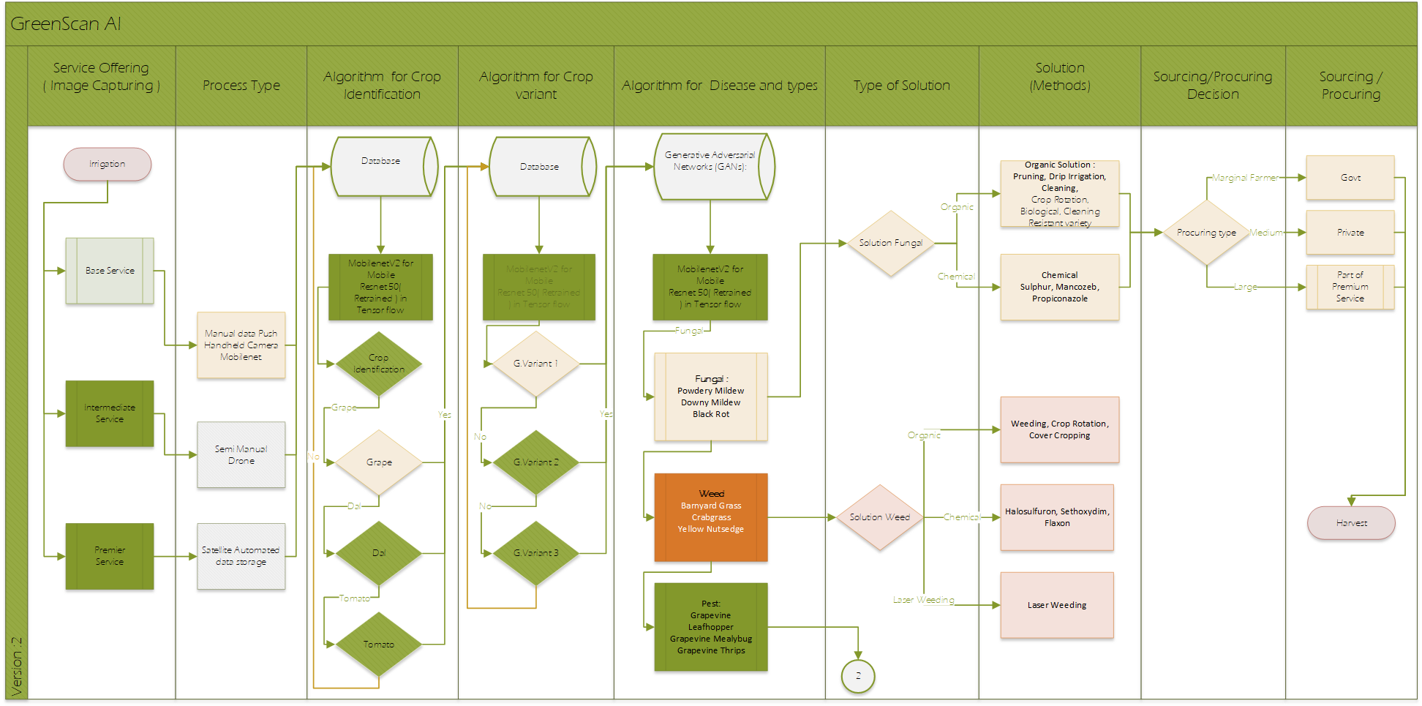
Solution Architecture
5. Product

Slide 10
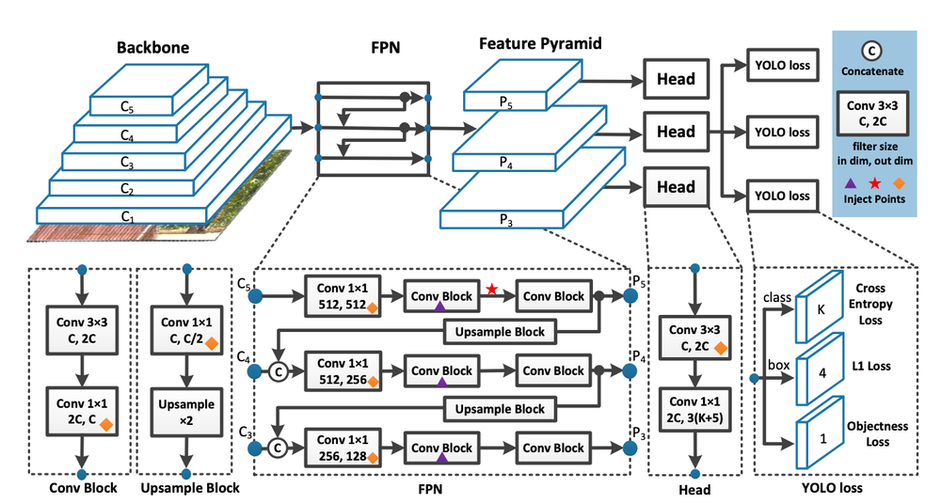
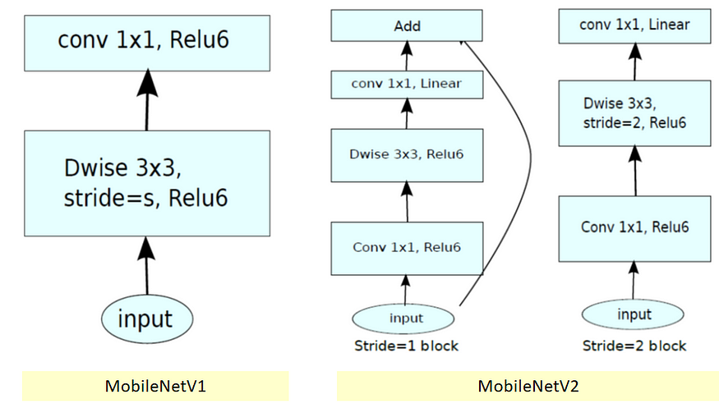
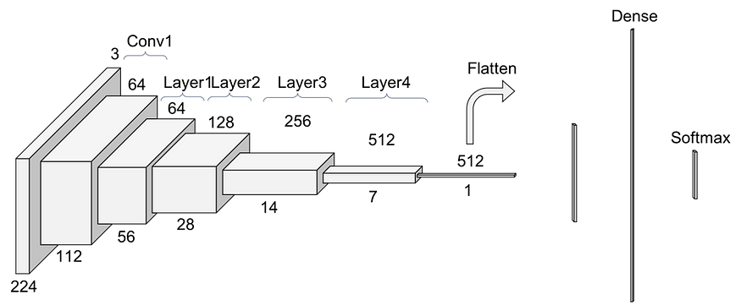
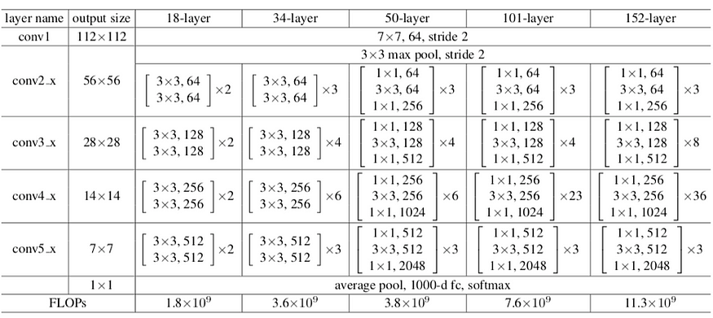
AI Algorithms
YoloV7
MobileNetV2
Plant Type Classification
For Plant Disease Classification Using MobileNetV2 - 98.65%(for Mobile Devices)
ResNet
Plant Diseases Classification - ResNet 99.2% (Drones and Satellite)

Slide 11
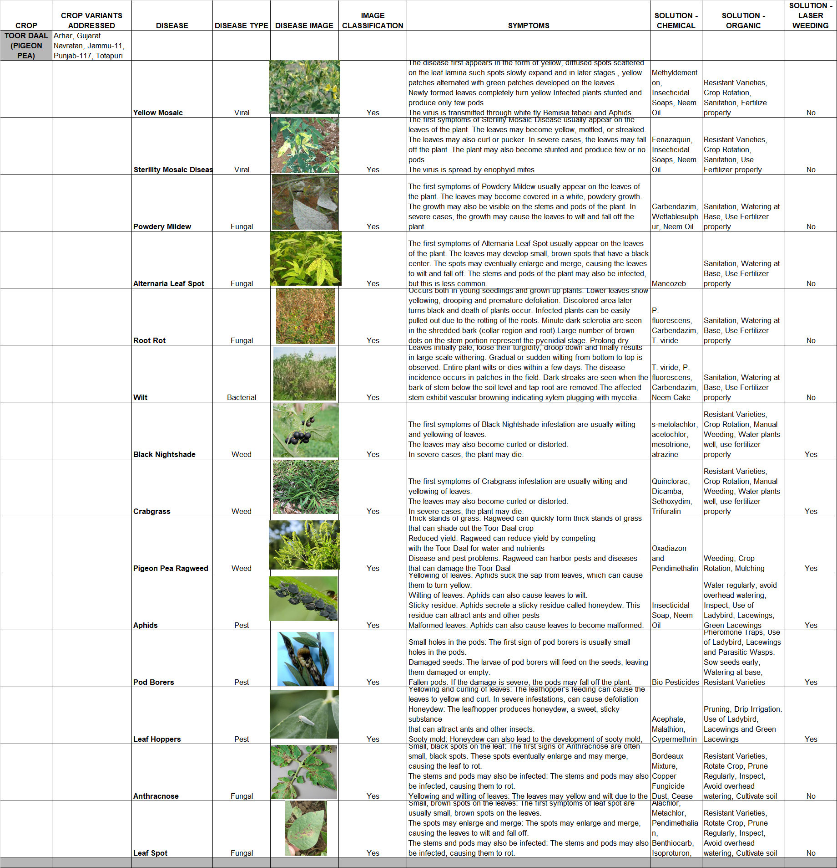
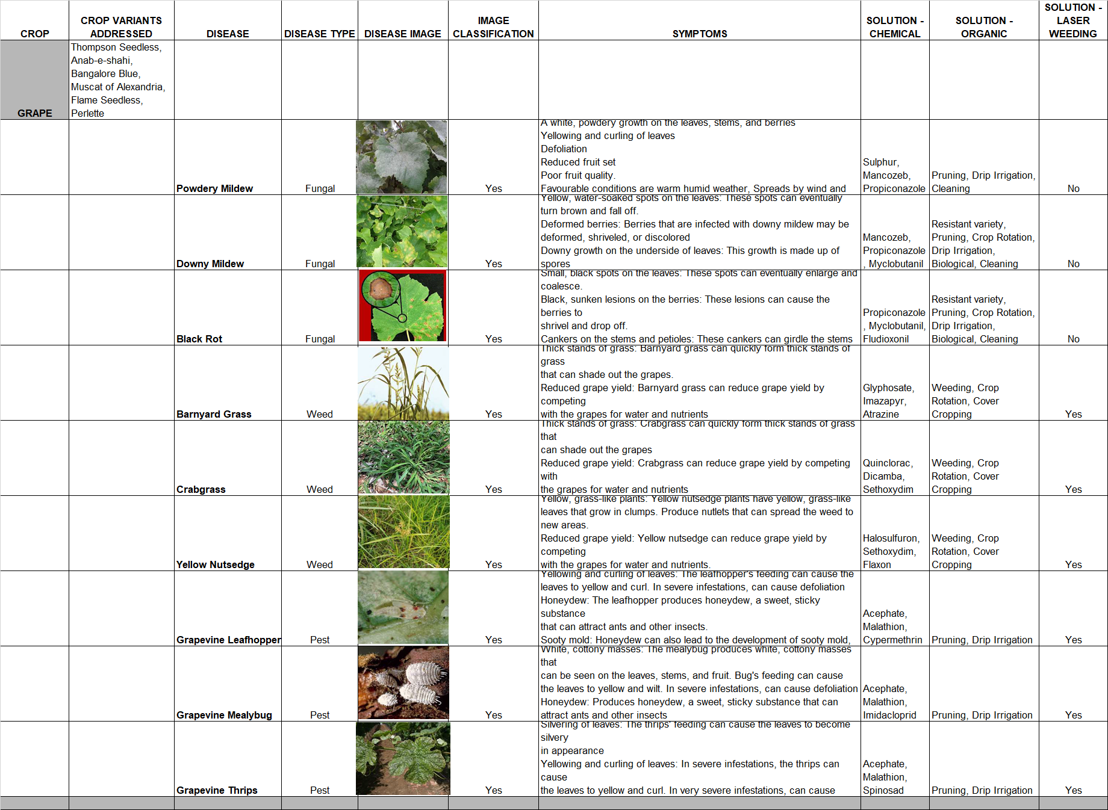
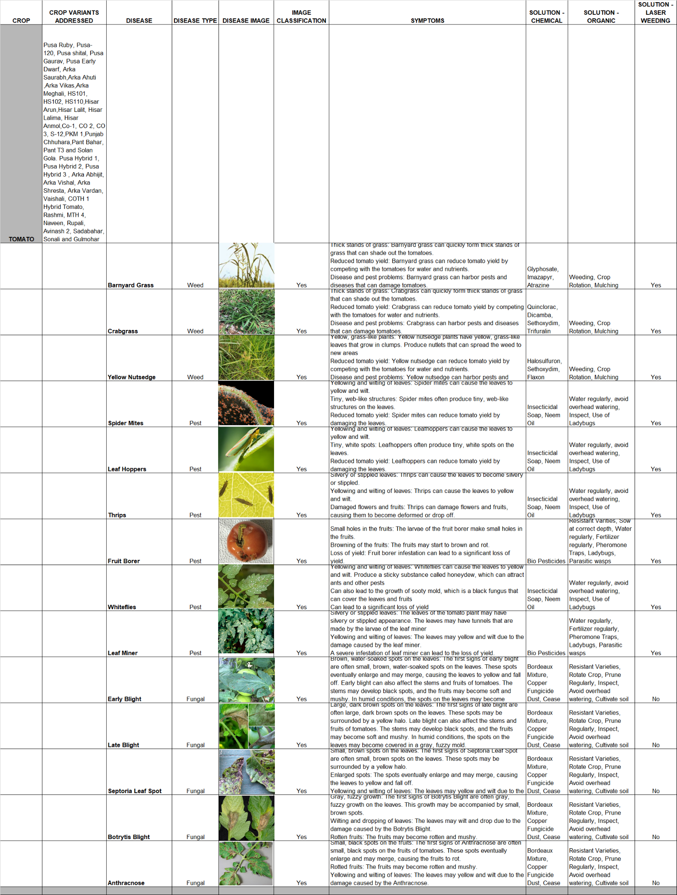
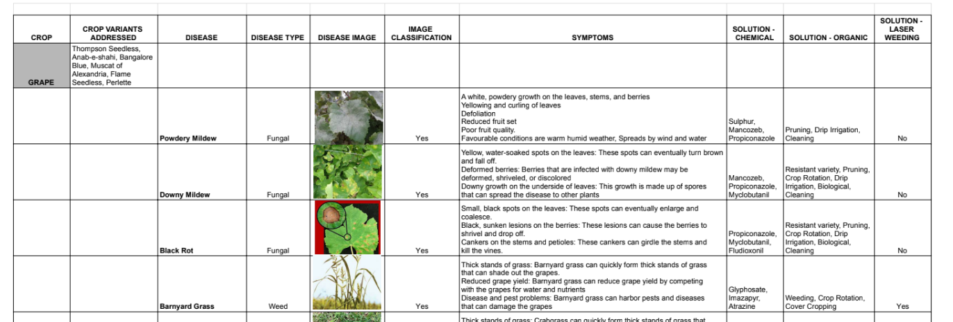
Crop Specific Solution
Grape
Tomato
Toor Daal
We have done a detailed research on these 3 Crops identifying close to 37 Diseases with images and relevant solutions in Organic, Chemical and Laser Weeding domain

Slide 12
SWOT Analysis
STRENGTH Comprehensive Product Offering Reliable Design with proven AI models Offline Connectivity Transfer Learning to replicate solution for more crop and region Scalable Solution Subscription based model Lean Team | WEAKNESS Market is fickle and can accept or deny a solution in an instant Needs an extensive ground based team to help ensure proper implementation Depends on capability of Device used Meeting Service Cost expectation is a challenge
OPPORTUNITY Regulations and Govt Support Technology Landscape. Internet connectivity and usage of Smartphones Economy. Increasing demand for Agri Produce Market. Strong Export Potential Climate Changes. Tackling unpredictability | THREAT Competitor Entry - Segment is seeing large scale investments in new startups. Need to be careful and maintain the first mover advantage Ground Level Connect. Failure to develop strong ground level connect with Farmers will lead to lack of trust and hamper business

Slide 13
Requirements
6. Requirements - Data and People
PEOPLE
Technical Team (8-9)
AI Research and Development Lead (1), 1st Month
Data Scientist (1) 1st Month
Software Developers (2–3), 2nd Month
Image Processing Specialist (1), 3rd Month
Mobile App Developer (1), 3rd Month
Cloud Engineer (1), 2nd Month
UX/UI Designer (1), 1st Month
Operations Team (4-5)
Operations Manager (1), 4th Month
Field Support Specialists (2–3), 4th Month
Partnership and Collaboration Manager (1), 3rd Month
Marketing Team (4)
Marketing Manager (1), 5th Month
Content Writer (1) 5th Month
Digital Marketing Specialist (1), 5th Month
Community Engagement Manager (1), 4th Month
Customer Support Team (3-4)
Customer Support Manager (1), 6th Month
Customer Support Manager (1), 6th Month
Research and Partnerships Team (2)
Research and Insights Lead (1), 1st Month
Strategic Partnerships Manager (1), 3rd Month
DATA
Crop Images - Different growth stages
Healthy Crop Images - To enable AI to understand the healthy crop looks like
Diseased Crop Images

Slide 14
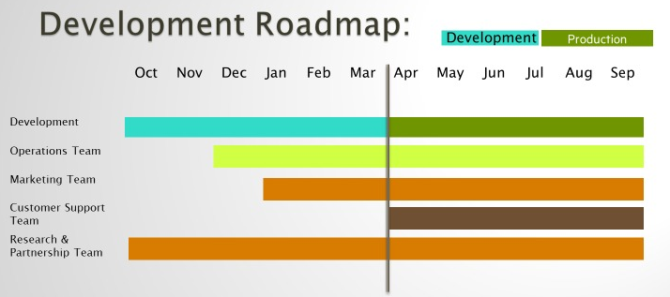
Development Roadmap
7. Product Development Roadmap

Slide 15
Expansion Plan
8. Expansion Plan
The product will be launched as an App with a Subscription model that depends on level of Service required. We will also be launching this in defined geographical areas initially. Once the initial launch feedback is received we will proceed with following stages,
Addition of Geographical Regions for the same Crop - Development of ground team and Drone + Satellite support teams.
Addition of more Crops. - Pilot and National launch. Addition of crop experts, collaboration with research institutes and service provider teams for field support.
Addition of Functionalities - More features like Expert on Call, Soil Analysis, Marketplace support. Buying of all essential commodities for farming, equipment purchase, selling of produce will all be integrated for an all round solution for the Farming Ecosystem.
International Markets Launch - Relevant partnerships and teams will be built over the coming years for this.

Slide 16
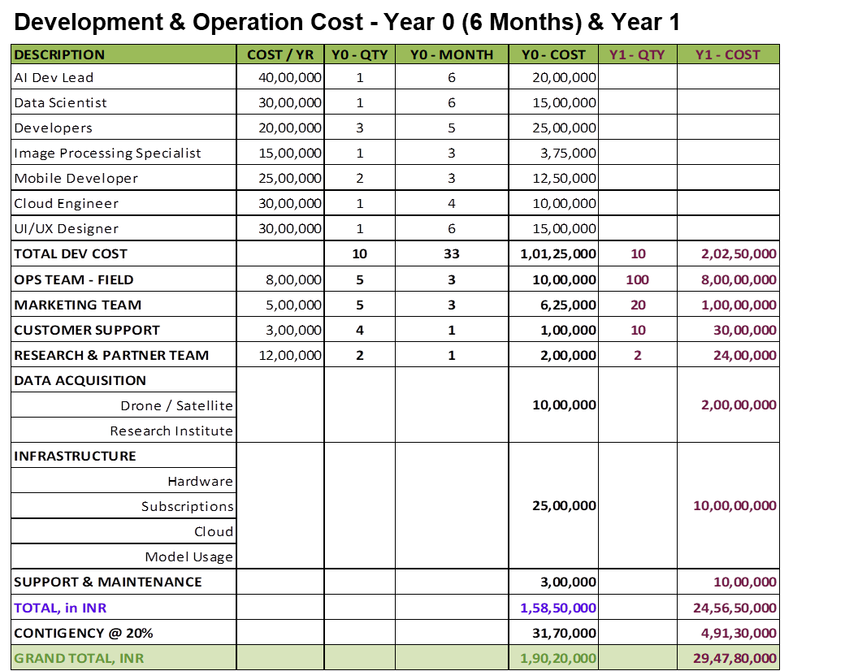
Revenue Model – Cost Summary
9. Business Model - Financials

Slide 17
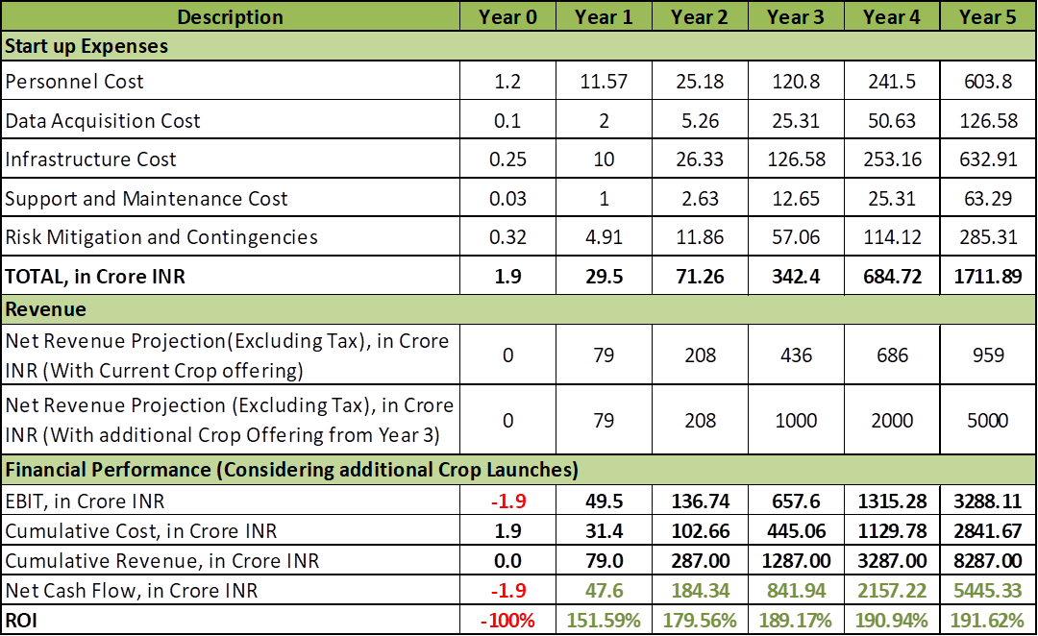
ROI

Slide 18
Thank You

